Slide 1
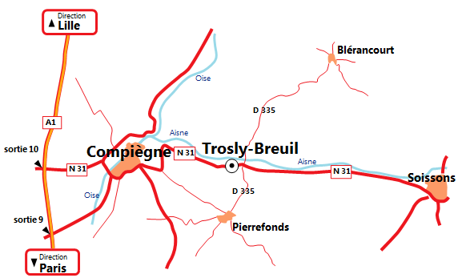
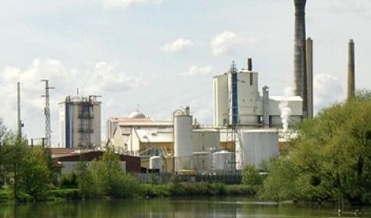
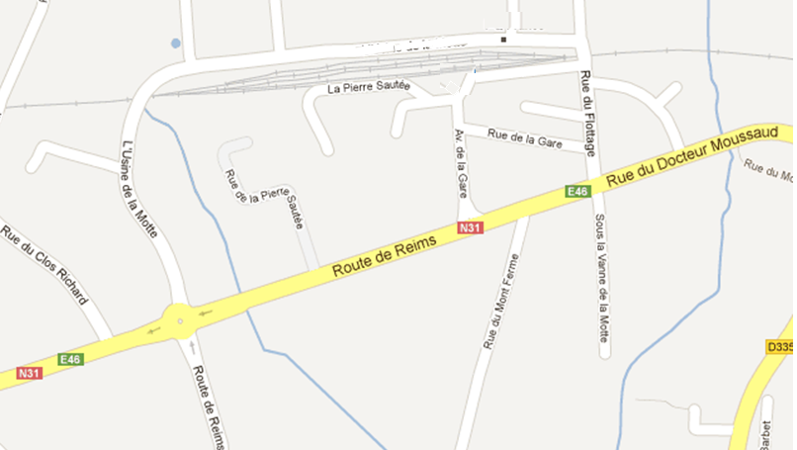
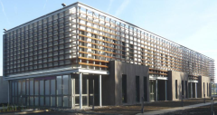
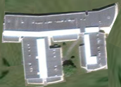
Access plan for the Lamotte industrial platform
From Paris: Take the A1 motorway towards Lille. Take exit 10 towards Compiègne West / Arsy Take N31 / E46 towards Compiègne / Noyon Near Compiegne, take N1031 Follow the direction Soissons / Reims At the roundabout in Trosly-Breuil, take the third exit (industrial area) From Compiegne : Follow the direction Soissons / Reims Drive through Trosly-Breuil village to the roundabout, then follow the directions to reach your destination (see below) From Soissons : Follow signs Compiègne Take the first right after entering Trosly-Breuil village
(2) Guardhouse
Rue des Aérostiers
F- 60350 Trosly Breuil
Tel 00 33 3 44 85 40 03
(3) Laboratory
Latitude 49°24’12,66” N
Longitude 2°59’34,42”E
Head office visitors (1) At the roundabout in Trosly-Breuil, take the first exit (industrial area) After the truck parking take the first right and go to the head office entrance. Industrial site visitors (2) and Research and Analytics laboratory visitors (3) Take the street “rue du Flottage” and go to the guardhouse.
Rue
des
(1) Head Office
Aréostiers
Aout 2020

